Slide 1

Optical communications and data networks (EENGM2001) Week13_Lecture003_ASync_Laser
Siddarth K Joshi

Slide 2
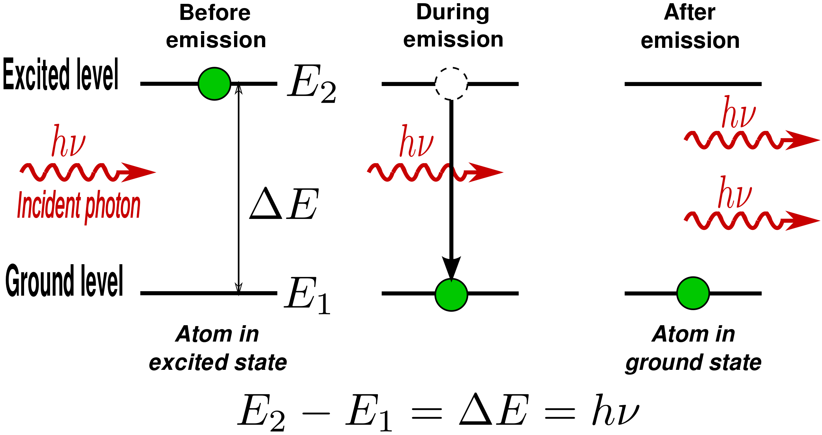
Laser
Light amplification by stimulated emission of radiation
h is planks constant and ν is the frequency
h = 6.62607004 × 10⁻³⁴ m²kg/s
Any system with discrete energy levels can be made into a laser.
Most common are semiconductor lasers.

Slide 3



Semiconductor laser diode
Gain
Semiconductor lasers (as any laser) are optical oscillators that generate ‘coherent’ light waves.
As any oscillator, there needs to be an amplifier (gain), a feedback mechanism, and a frequency selection mechanism.
When gain of amplifier is sufficiently high to overcome loss of energy in one feedback loop, oscillation happens.
Freq.
selection
loss
Electronic oscillator
Gain threshold: the minimum gain needed to overcome the loss:
Gain - Loss > 0
The necessary condition for any oscillator to work
This means that all lasers have a ‘threshold’ , i.e., a minimum amount energy needs to be put in before it emits light

Slide 4
Laser
Stimulated emission:
Photons are created when electrons & holes recombine in direct bandgap semiconductors
When such emission is caused by an original photon, it is called stimulated emission
Optical Gain
Every stimulated emission event creates an exact copy of the original photon: – a coherent photon
same energy (hence same frequency),
same direction of travel (same wave vector)
same polarization
same phase
Optical gain is achieved because the total amount energy in the light wave is doubled

Slide 5
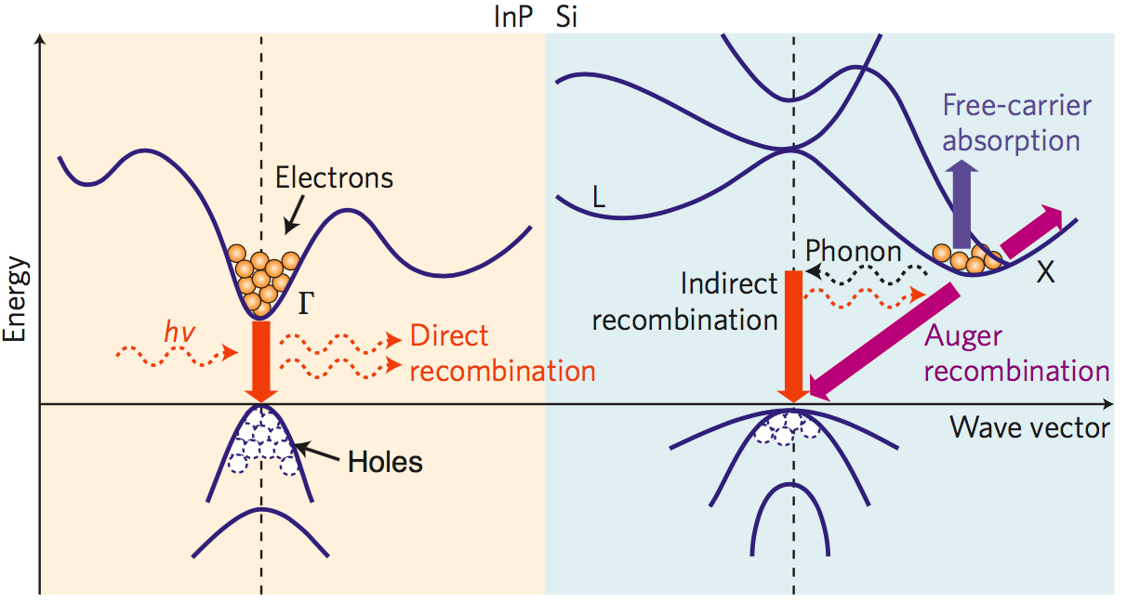
Types of semiconductors
GaAs or
Direct bandgap
Indirect bandgap

Slide 6
Laser
free electrons and hole are injected into the C-band and V-band respectively by an electric current
When an electron falls from C- to V-band, it recombines with a hole, emit its energy as a photon.
This recombination can happen automatically (spontaneous emission)
It can also happen under influence of another photon (stimulated emission)
Energy of photon is E_{g}
E (electron energy)
-
Conduction band
E_{C}
-
-
-
K (electron momentum)
E_{g}=E_{C}-E_{V}
E_{V}
+
+
+
Valence band
+
-E (hole energy)

Slide 7
Laser
Stimulated emission:
Coherent process
Provides optical gain leading to ‘lasing’, i.e., generating coherent light wave
Spontaneous emission:
Incoherent process: SE photons are not related to the laser light in frequency, phase or polarization
Hence SE results in noise
But the lasing process wont start without the SE photons to ‘seed’ the laser

Slide 8
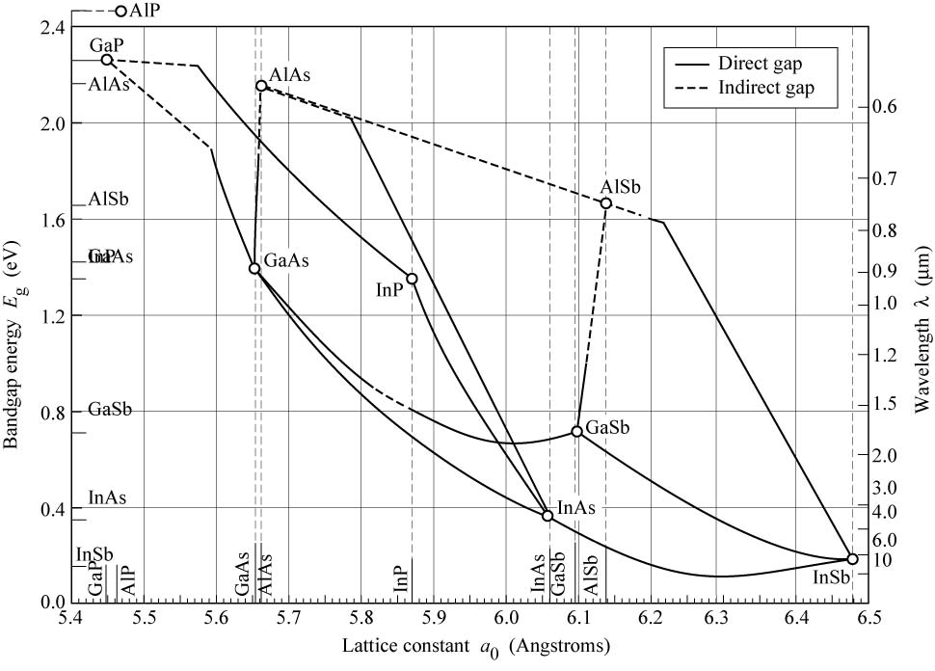
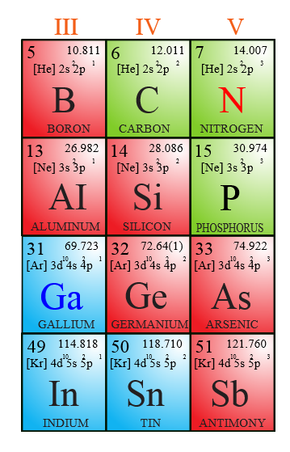
Which semiconductors?
GaAlAs
InAlAs
Bandgap energy
InGaAsP
InGaAlAs
InGaAs
Lattice constant (Angstrom)
1 angstrom (Å) = 0.1nm

Slide 9
Bandgap of commonly used III-V compound semiconductors
GaAs / Al_{x}Ga_{1-x} As / AlAs
Eg = 1.424+1.247x (eV) for x<0.4
λ₀ =850 nm ➔ 1.46 eV ➔ x≈ 0.3
InP / In_{x}Ga_{1-x}As_{y}P_{1-y} / InGaAs
Eg between 1.34 eV (InP) to 0.75 eV (Ga_{0.47}In_{0.53}As)
λ₀ =1550 nm ➔ 0.8 eV
λ₀ =1300 nm ➔ 0.95 eV
Optical gain is provided in a range of wavelengths around these values
1eV = 1.60218E-19 J

